Slide 1

Summary of Fake Reviews Method
Farnaz Tahmasebian
Notes:
http://www2.cs.uh.edu/~arjun/

Slide 2
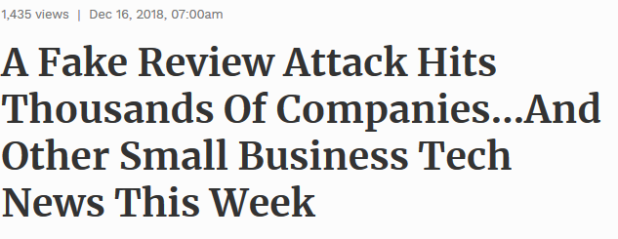


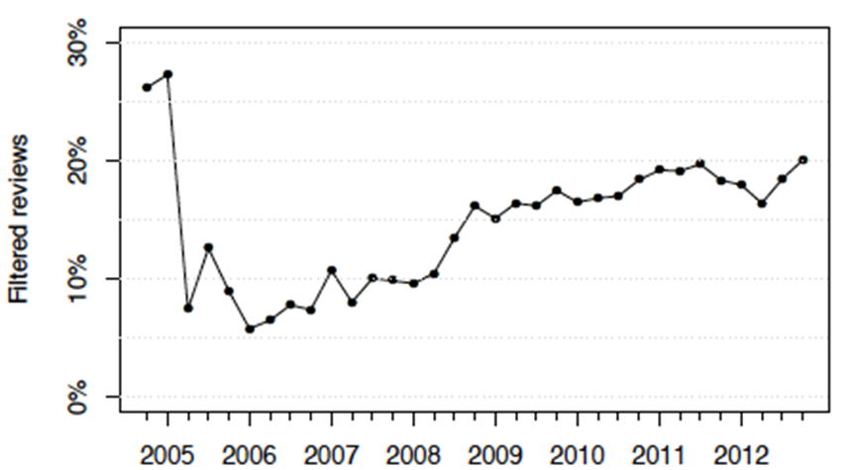
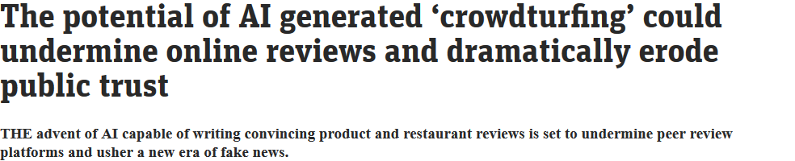
Problem
Reviews present a new way to learn about product quality
Around 20% reviews on Yelp are estimated to be faked by paid human writers, which is misleading when consumers are making decisions.
Impact of review: 1 star increase leads to a 5% increase in revenue for independent restaurants*
*Reviews, Reputation, andRevenue: The Case ofYelp.com, Harvard Study by M. Luca
Notes:
1 — A massive fake review attack has a big impact on small businesses.
The Local SEO community was recently the victim of a massive fake review attack that impacted small businesses globally when a collection of 37 profiles left over 3 million fake 4-star ratings. By the time Google removed them all about five days later, the average profile had left over 81,000 ratings for various businesses. Though it’s not clear who initiated the attack, most of the profiles had Vietnamese usernames, but the majority of the ratings were left for American SMBs. (Source: Search Engine Land)
Type of spams: Duplicate (easy, string matching)
Advertisements
Other easy-to-detect spams (all symbols, numbers, empty, etc.)
Untruthful (very hard, need machines to understand the intentions of the reviews)

Slide 3
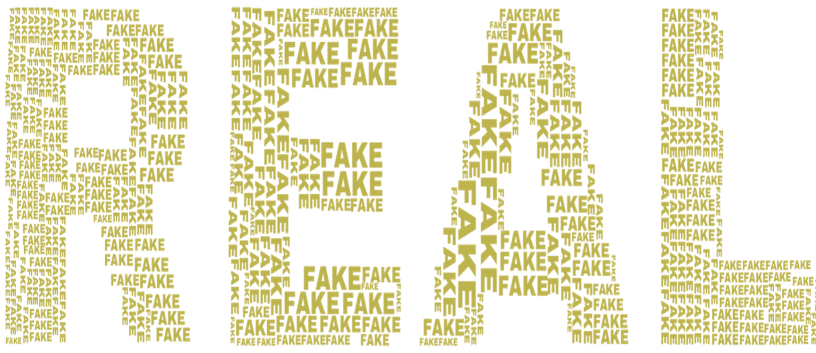
Can you Spot the fake reviews about Sydney restaurants?
1) “This place is amazing! The bartenders are absolutely amazing. The pasta is delicious and I love their pastries and it is amazing. I love the breakfast, friendly staff and the price is very reasonable. I have never had a bad experience here. I will be back for sure!”
2) “DO NOT WASTE YOUR TIME AND MONEY! The absolute worst service I have ever experienced. This place is a joke. The waitress was rude and said she would put the manager to come out but never happened. I wish I could give zero star.”
3) “A disappointing experience. Totally overpriced for what you get, unfriendly and slow service, average food. Definitely not worth the money.”
4) “I opted for the BBQ pork laksa and it was served in a matter of minutes for a measly $12.00. The BBQ pork was delicious and the laksa was piping hot with a slight chilli hit. I also chose 2 types of noodles for my soup because 2 is better than 1. I would have liked a few more veggies but the serving was generous enough.”
5) “I was here for a weekend brunch and the food was OK. I love the pizza that is a chain restaurant. I think the service is excellent. I had the spaghetti and they were very good and the hot dog was good. I got the red velvet chocolate cake special which was very good but the service was a little slow. The food was good, but not up to par with other places nearby.
* Generated by Prof Zhao and his team

Slide 4

Can you Spot the fake reviews about Sydney restaurants?
1) “This place is amazing! The bartenders are absolutely amazing. The pasta is delicious and I love their pastries and it is amazing. I love the breakfast, friendly staff and the price is very reasonable. I have never had a bad experience here. I will be back for sure!”
2) “DO NOT WASTE YOUR TIME AND MONEY! The absolute worst service I have ever experienced. This place is a joke. The waitress was rude and said she would put the manager to come out but never happened. I wish I could give zero star.”
3) “A disappointing experience. Totally overpriced for what you get, unfriendly and slow service, average food. Definitely not worth the money.”
4) “I opted for the BBQ pork laksa and it was served in a matter of minutes for a measly $12.00. The BBQ pork was delicious and the laksa was piping hot with a slight chilli hit. I also chose 2 types of noodles for my soup because 2 is better than 1. I would have liked a few more veggies but the serving was generous enough.”
5) “I was here for a weekend brunch and the food was OK. I love the pizza that is a chain restaurant. I think the service is excellent. I had the spaghetti and they were very good and the hot dog was good. I got the red velvet chocolate cake special which was very good but the service was a little slow. The food was good, but not up to par with other places nearby.”
* Generated by Prof Zhao and his team

Slide 5
Fake Review Detection
Detect fake reviews written by human (Crowdsourced or Expert Generated):
ML-based Review filter
Employs the language processing method to detect unusual patterns of text, writing style, and formatting.
Detect the fake reviews generated by AI

Slide 6
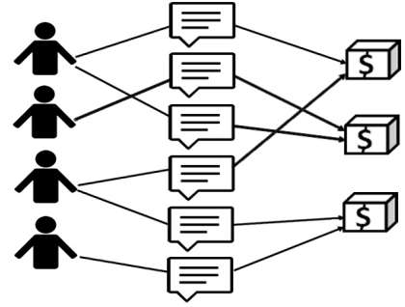
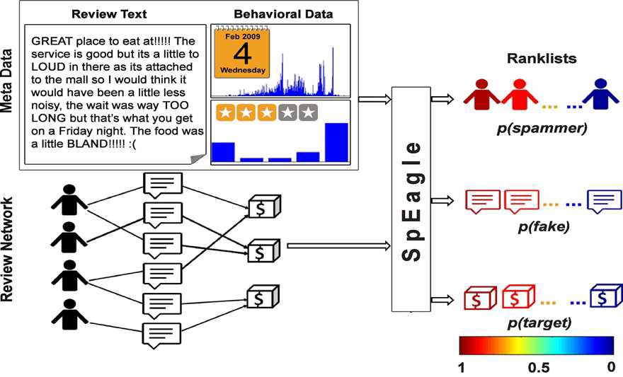
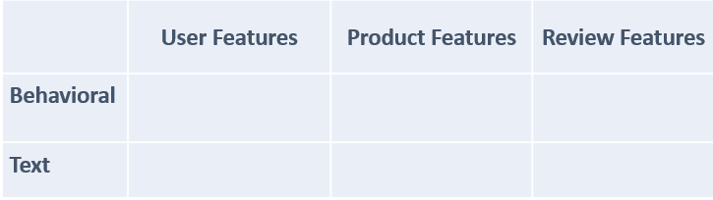
Fake Review Detection written by human
Related to:
Review
Product
Reviewer,
Meta data
Such as network
behaviors
Extracting Features
SVM/NB/LR
Detect fraudulent reviews
Notes:
Jindal et al. [3] first introduced deceptive opinion spam problem as a widespread phenomenon and showed that it is different from other traditional spam activities. They built their ground truth dataset by considering the duplicate reviews as spam reviews and the rest as nonspam reviews. They extracte features related to review, product and reviewer, and trained a Logistic Regression model on these features to find fraudulent reviews on Amazon.
Wu et al. [39] claimed that deleting dishonest reviews will distort the popularity significantly. They leveraged this idea to detect deceptive opinion spam in the absence of ground truth data. Both of these heuristic evaluation approaches are not necessarily true and thorough.
Yoo et al. [19] instructed a group of tourism marketing students to write a hotel review from the perspective of ahotel manager. They gathered 40 truthful and 42 deceptive hotel reviews and found that truthful and deceptive reviews have different lexical complexity.
Ott et al. [4] created a much larger dataset of 800 opinions by crowdsourcing 3 the job of writing fraudulent reviews for existing businesses. They combined work from psychology and computational linguistics to develop and compare three approaches for detecting deceptive opinion spam.
On a similar dataset, Feng et al. [33] trained Support Vector Machine model based on syntactic stylometry features for deception detection.
Li et al. [18] also combined ground truth dataset created by Ott et al. [4] with their employee (domain-expert) generated deceptive reviews to build a feature-based additive model for exploring the general rule for deceptive opinion spam detection.

Slide 7
Extracting Features
Similarity feature:
Captures inter-sentence similarity within a review at the word level.
It is computed as the maximum cosine similarity between unigram features among all pairs of sentences
Spammers likely to copy reviews across similar product. Choose maximum similarity to capture worst spamming behavior.
Lots of positive reviews left within a short time-frame, often using similar words and phrases
Multiple reviews using similar language and listing the same benefits
Structural features :
Individual features include the number of words, the number of sentences, the average sentence length (# of words) and the average word length (# of characters).
Syntactic features :
Captures the linguistics properties of the review based on parts-of-speech (POS) tagging.
Features include (distinct) percentages of nouns, verbs, adjectives and adverbs, first personal pronouns, and second personal pronouns
Negative fake reviews contained less spatial information and had a larger verb-to-noun ratio than truthful reviews.

Slide 8
Extracting Features
Semantic features :
Captures the subjectivity and sentiment of the reviews. Features include percentage of subjective words, percentage of objective words, percentage of positive words and percentage of negative words.
Deception words in fake reviews indicates projection in positive light. CDF of positive(4-5 stars) reviews among all reviews is plotted to illustrate analysis.
Lots of 5 star reviews with really short content – generally when somebody is delighted enough to leave a 5 star review, they’ll wax lyrical about the product with lots of detail
LIWC features : The Linguistic Inquiry and Word Count (LIWC) software is a widely used text analysis tool in the social sciences.
It categorizes ∼4,500 keywords into ∼68 psychological classes (e.g., linguistic processes, psychological processes, personal concerns and spoken categories).
Use the percentage of word count in each class as a feature, and exclude the features already included in the previous groups.

Slide 9
Behavioral:
Spammers mostly like to give extreme ratings(1 or 5) in order to boost ratings to demote or promote products
Posting many reviews a day is also abnormal.
Spammers are usually not longtime members of site.
Post reviews with high rating under different names in a short time
The results: in a short time, many reviewers wrote only one review with a very high rating
The correlations between rating and volume of (singleton) reviews is the key feature of singleton review spamming
Standard deviation of ratings

Slide 10
FAKE Review Detection
Linguistic n-gram features and supervised learning
Poor performance of n-grams for Yelp data because spammers according to Yelp filter used very similar language in fake review as non-fake review : linguistically very similar
For AMT data, word distribution of fake and non-fake reviews are very different, which explains the high accuracy using n-gram.
Notes:
[1] Mukherjee et al : http://delivery.acm.org/10.1145/2490000/2487580/p632-mukherjee.pdf
[2] Mukherjee, A., Liu, B. and Glance, N. 2012. Spotting Fake Reviewer Groups in Consumer Reviews. WWW (2012).
Using only Bigram features : accuracy of 89.6% on AMT data. [1]
Using same n-gram features : accuracy of 67.8% on Yelp Data.[2]
Class distribution of Yelp data is skewed – imbalanced data produces poor model.(Chawla et al, 2004)
Good model for imbalanced data – under sampling. (Drummond and Holte, 2003)
KL(F||N) Definition implies that words having higher probability in F and very low
probability in N contribute most to KL-Divergence.
Yelp fake review data shows KL(F||N) is much larger than KL(N||F) and ΔKL>1.

Slide 11
Observations
“(a) Deceptive reviews contain more words.
(b) Deceptive reviews are less complex.
(c) Deceptive reviews are less diverse.
(d) Deceptive reviews contain less self-references.
(e) Deceptive reviews contain a greater number of references to the hotel brand.
(f) Deceptive reviews contain a greater percentage of positive words.
(g) Deceptive reviews contain a smaller percentage of negative words.”
Notes:
Hypotheses (e–g) were confirmed, while (a–d) were not. In fact, the opposite hypotheses to (b) and (d) received
support: fake reviewers used more complex language and more self-references than truthful reviewers. ese results
imply that fake reviews may differ from other types of deception by oen being conducted by experts. Further, based
on O et al.’s results [128, 129], it seems likely that (f–g)’s success was due to the reviews’ promotional nature, and
would plausibly not be replicated on negative review data.

Slide 12
Challenge in DataSet
largest corpus of elicited fake reviews has been compiled by Ott et al. and contains 400 fake and 400 truthful reviews of both the positive and negative kind.
The Yelp provides a corpus of filtered reviews suspected to be fake

Slide 13
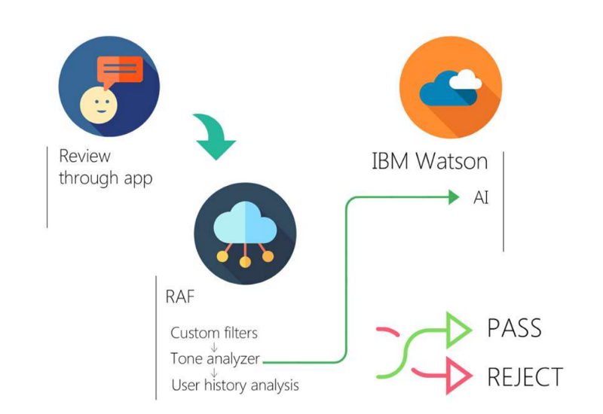
IBM Watson
Tone analyzer feature of IBM Watson, is able to automatically determine an emotional component of reviews.
‘Oh, this place sucks, such a bullshit, never ever again shall I be back here!!’
Tone Analyzer will instantly be able to detect suspicious features and suggest this review to be fake, using such criteria as:
Anger, Disgust, Sadness levels, Language Style and Social tendencies.

Slide 14
Fake review detectors
Fakespot
Analyse and sort product reviews on Amazon, Ebay
Analyzes the reviews in order to identify repeated words and phrases, frequency, dates, purchasing patterns and verified purchases to produce a list of reviews which are likely to be fakes.
ReviewMeta
Analyze millions of reviews in order to help you choose which ones to trust.
System will produce a result of ‘Pass’, ‘Warn’ or fail to help guide a buyer’s decision.
Analyze reviews based on language used within reviews, frequency of reviews, how soon after listing reviews are received and the number of reviews which are unverified.
The Review Index
Analyses a product’s link to produce an educated guess as to the authenticity of the product’s reviews.
The system will then produce a summary of the number of reviews, the number which are unverified and will also include a written summary noting whether or not recurring patterns have been detected which may suggest fake reviews.
Although a little more basic than Fakespot.com and Reviewmeta.com

Slide 15
AI Generated Fake Reviews
Notes:
http://www2.cs.uh.edu/~arjun/

Slide 16
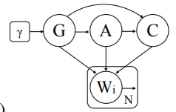
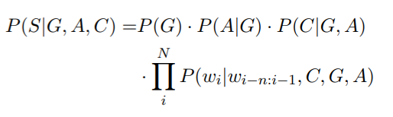
AI generated fake reviews (Hovy)
Generator: Hovy automatically generated fake reviews using a 7-gram Markov chain trained with data from the review site Trustpilot.
Detector: For classification, he used logistic regression with word n-grams (1 - 4) as features.
Notes:
The Enemy in Your Own Camp: How Well Can We Detect Statistically-Generated Fake Reviews – An Adversarial Study
Adding such meta-information to the model significantly improved its ability to fool the classifier.
However, while exact copies of training reviews were removed, a 7-gram model will likely reproduce large chunks of the training data. Duplicate or similarity detection between the training data and the generated reviews was not conducted by Hovy.
n the generative story of this model, we firstdraw a user from one of the two genders in ourdata, select an age based on gender-specific agedistributions, and choose a review category depen-dent on the two pr
evious variables. We then thengenerate a sentence conditioned on all of these set-tings and the Markov horizon.
nitially, we would like to establish whetherconditioning LMs on demographic informationhas any effect on detection. For this purpose,we compare the performance of the logisticregression model on (1) a test set including fakereviews generated by an unconditioned 7-gramLM and (2) a test set whose fake reviews havebeen conditioned on meta-information. In bothcases, the detector has only access to the basefeatures, i.e., ignores demographic information.This is equivalent to a situation where the judgecan only see the text, not the meta information.

Slide 17
AI generated fake reviews (Yao et al. )
Yao et al. generated fake reviews with a character-level Recurrent Neural Network (RNN) trained with restaurant reviews from Yelp.
Were unable to distinguish RNN-generated reviews reliably from those in the Yelp corpus,using:
Linear SVMs with various linguistic features,
Plagiarism detection method Winnowing ,
Human evaluators from Amazon Mechanical Turk
Defence against their RNN-generated fake reviews:
Statistical differences in character distributions between generated reviews and the training corpus.
Notes:
Yuanshun Yao, Bimal Viswanath, Jenna Cryan, Haitao Zheng, and Ben Y. Zhao. 2017
(In Proceedings of the 2017 ACM SIGSAC Conference on Computer and Communications Security (CCS '17). ACM, New York, NY, USA, 1143-1158. DOI: https://doi.org/10.1145/3133956.3133990)
Automated Crowdturfing Attacks and Defenses in Online Review Systems

Slide 18
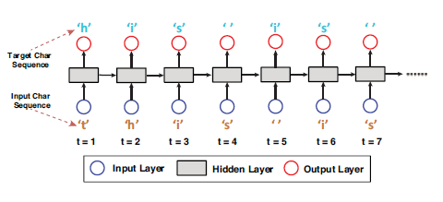
RNN- as a Text Generative Model
Focus on character level
The hidden layer to capture the relationship between each input and characters prior to it
Conditional probability P (xt+1|(x1, . . . , xt))
Temperature controls the novelty of generated text (0 to 1)
Lower temperatures – less diverse text
Higher temperatures- novel text

Slide 19
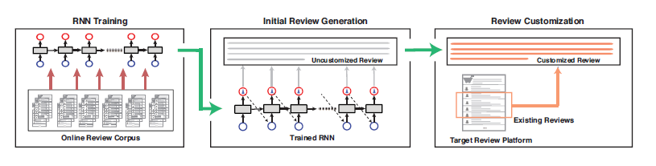
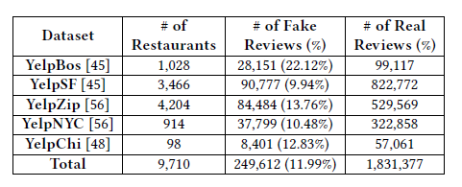
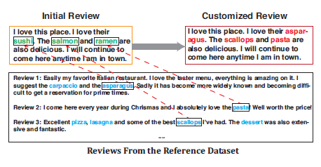
Problem – Attack Methodology
Training RNN on a review corpus
Generate initial reviews
Review customisation
Capture context, and change words
Datasets – focussed on Yelp
Text of review, identity of restaurant and the score
Three datasets
Training (57M Words, 304 characters)
Ground-Truth ( table below)
Attack (aligned with ground-truth)
Attack
Ground Truth
Training
Attack

Slide 20
AI generated fake reviews (Juuti et al. )
Juuti et al. utilized Neural Machine Translation (NMT) to generate context-appropriate restaurant reviews.
They include an encoder network and a decoder network, which are jointly optimized to produce a translation of one sequence to another.
The encoder rolls over the input data in sequence and produces one n-dimensional context vector representation for the sentence.
The decoder then generates output sequences based on the embedding vector and an attention module, which is taught to associate output words with certain input words.
The generation typically continues until a specific EOS (end of sentence) token is encountered. The review length can be controlled in many ways, e.g. by setting the probability of generating the EOS token to zero until the required length is reached.
Notes:
Juuti M, Sun B, Mori T, Asokan N. Stay on-topic: Generating context-specific fake restaurant reviews. InEuropean Symposium on Research in Computer Security 2018 Sep 3 (pp. 132-151). Springer, Cham.
1) the ability tolearnhow to associate context(keywords) to reviews

Slide 21
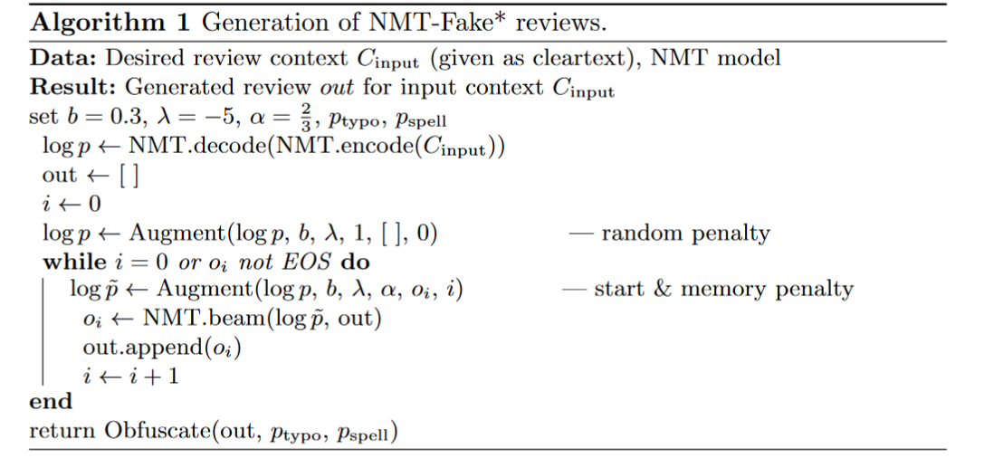
AI generated fake reviews (Juuti et al. )
B: controls how much of the vocabulary is forgotten
Λ: is a soft penalty of including “forgotten” words in a review
Notes:
Bernoulli penalties to language modelTo avoid generic sentences components,we augment the default language modelp(·) of the decoder by
Wetried several forms of added randomness, and found that adding constant penal-ties to arandom subsetof the target words resulted in the most natural sentenceflow. We call these penaltiesBernoulli penalties, since the rando m variables arechosen as either 1 or 0 (on or off)
with increasing values ofb: visibly, the restaurant reviews become more extreme.This occurs because a large portion of vocabulary is “forgotten”. Reviews withb≥0.7 contain more rare word combinations, e.g. “!!!!!” as punctuation, andthey occasionally break grammaticality (”experience was awesome”). Reviewswith lowerbare more generic: they contain safe word combinations like “Greatplace, good service” that occur in many reviews. Parameterλ’s is more subtle:it affects how random review starts are and to a degree, the discontinuationbetween statements within the review. We conducted an Amazon MechanicalTurk (MTurk) survey in order to determine what kind of NMT-Fake reviews areconvincing to native English speakers. We describe the survey and results in thenext section

Slide 22
Sample of Data
5 Public House Las Vegas NV Gastropubs Restaurants > Excellentfood and service . Pricey , but well worth it . I would recommendthe bone marrow and sampler platter for appetizers .
The order[rating name city state tags]is kept constant. Training the model conditions it to associate certain sequences of words in the input sentence with others in the output.

Slide 23
AI generated fake reviews (Juuti et al. )
Despite successfully deceiving human readers, they were able to detect generated reviews with a very high F1-score of 97%, using an AdaBoost classifier trained on words, POS n-grams, dependency tag n-grams, and NLTK’s readability features.

Slide 24
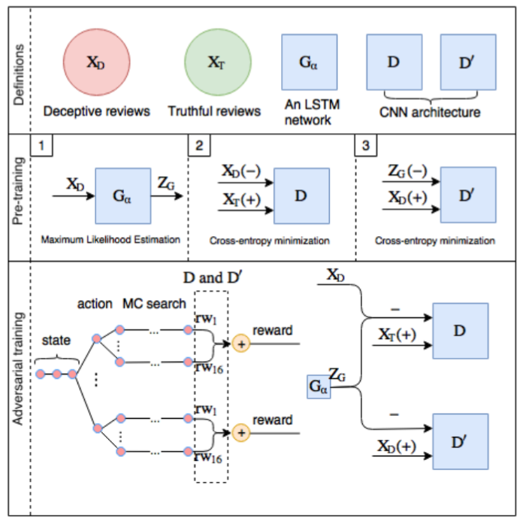
Detecting Deceptive Reviews using GAN
D :
Distinguish between X_{T} or (X_{D} U Z_{G})
Guide generator to produce sample similar to X_{T}
D’:
Distinguish between X_{D} or Z_{G}
Guide generator to produce sample similar to X_{D}

Slide 25
Recent developments in automatic text generation demonstrate that automating the task of fake reviewing is an increasing threat.

Slide 26
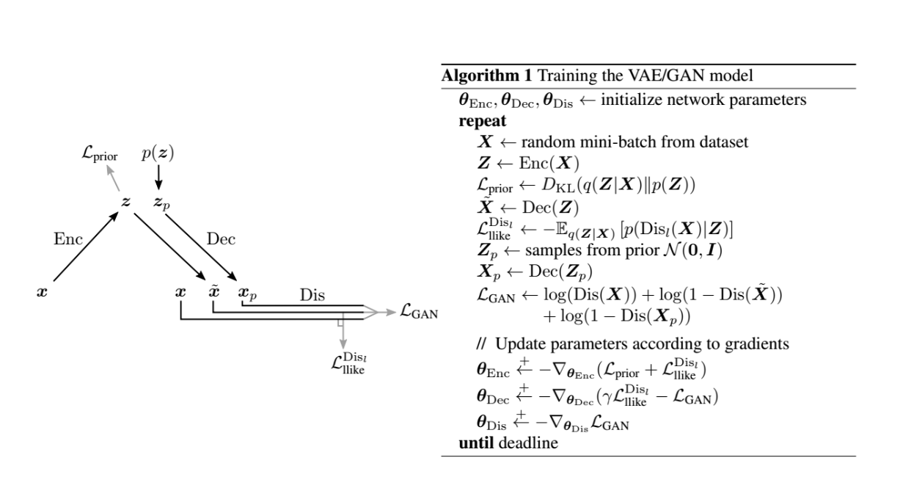

Slide 27





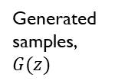

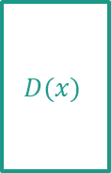






Preliminary Idea.
Input: POS tags associated with reviews
Reconstruct
reviews (x_tilde)
Generated samples, $G(z)$
Sample of
(y)
Discriminator
$$\overline{y}$$
$$G(z)$$
$$D(x)$$
$$\overline{y}$$
$$w_{1}$$
$$x$$
1
$μ$
0
$$\overline{y}$$
Data samples, x
FAKE
REAL
$$Σ$$
$$\overline{y}$$
Decoder(generator)
Generate using
SeqGAN based on
RL
Discriminator
$$G(z)$$
$$D(x)$$
Encoder
$$x$$
0
1
Data samples, x
FAKE
REAL
Reviews
Loss Generator :
Policy Gradient mode -
Loss encoder : prior + Cross entropy Disc(Reconstruct reviews , reviews)

Slide 28
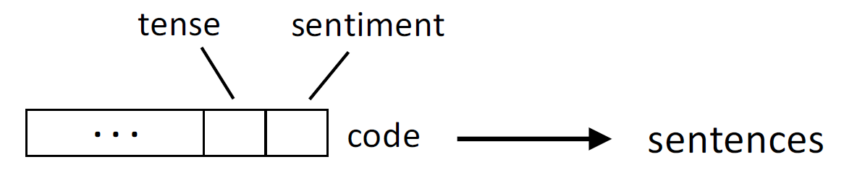

Input: POS tags associated with reviews
Reconstruct
reviews (x_tilde)
Generated samples, $G(z)$
Sample of
(y)
Discriminator
$$\overline{y}$$
$$G(z)$$
$$D(x)$$
$$\overline{y}$$
$$w_{1}$$
$$x$$
1
$μ$
$$code$$
0
$$\overline{y}$$
Data samples, x
FAKE
REAL
$$Σ$$
$$\overline{y}$$
Decoder(generator)
Generate using
SeqGAN based on
RL
Discriminator
$$G(z)$$
$$D(x)$$
Encoder
$$x$$
0
1
Data samples, x
FAKE
REAL
Reviews
Loss Generator :
Policy Gradient mode -
Loss encoder : prior + Cross entropy Disc(Reconstruct reviews , reviews)

Slide 29
Thank you
Any question?

